Slide 1


Development of master curricula for natural disasters risk management in Western Balkan countries
NatRisk project
Work package 4
Implementation of developed master curricula and trainings
Emina Hadžić
Milan Gocić
London, 21st March 2019
Project number: 573806-EPP-1-2016-1-RS-EPPKA2-CBHE-JP
"This project has been funded with support from the European Commission. This publication reflects the views only of the author, and the Commission cannot be held responsible for any use which may be made of the information contained therein"

Slide 2
Development of master curricula for natural disasters risk management in Western Balkan countries
Work pakage 4.
Implementation of developed master curricula and trainings
4.1 | Defining of admission requirements and enrolment of students
4.2 | Implementation of master curricula
4.3 | Implementation of students’ internships
4.5 | Self-evaluation of master curricula
Related assumptions and risks to fulfill tasks:
Asumptions:
- Students are interested in master studies in the field of risk management of natural disasters.
- Accreditation of curricula completed.
- Representatives from public sector and citizens are interested for trainings.
Risks:
-Incompatibility of duration of master studies with the present state
-The accreditation process delays.
- The cooperation protocols with partners from public sector signed but not respected.
Notes:
Na početku projekta su jako dobro prepoznati rizici vezano za wp 4
Vidjeti sa Milanom u kojoj je fazi svaka od wb institucija?????

Slide 3
Description
Development of master curricula for natural disasters risk management in Western Balkan countries
In this WP students will enrol to master studies in the field of risk management of natural disasters.
Certain number of students from each WB HEI will visit EU partner HEIs, attend lectures and compare their acquired knowledge with the knowledge and skills of colleagues from EU.
Self-evaluation on quality of master curricula will be regularly performed
To the newly enrolled students will be offered student internships at the WB partner institutions and within the entities from public sector. The number of ECTS for this activity will be harmonised with international recommendation and National accreditation body rules.
The educational trainings will be organized for citizens and public sector in the field of risk management of natural disasters with aim to raise awareness about risks of natural disasters.
Evaluation of the trainings’ quality is planned.
The trainings for citizens and public sector in NDRM will be delivered in the centres for lifelong learning at universities (where it is applicable) and the certificate of acquiring the key skills in NDRM will be issued at the end of training completion.

Slide 4
Tasks
Development of master curricula for natural disasters risk management in Western Balkan countries
Enrolment of students to master studies.
Implementation of master study programmes.
Quality monitoring of the master programmes will be conducted.
Providing and implementation of the students' internship.
Implementation of trainings for citizens and public sector.
Self-evaluation of the trainings.

Slide 5
WP 4.1. Students enrolled
Development of master curricula for natural disasters risk management in Western Balkan countries
New master students will be enrolled at each WB partner HEI starting from October 2018. The teaching of the new courses will start during the life time of the NatRisk project and will take place during the whole third year of the project duration.
This activity includes: call for enrolment on master studies in the field of risk management of natural disasters, with defined conditions for enrolment, ranking students, inscription of selected students. Each WB HEI will enrol 10-15 students except UNI (20-30 students).
Due date | 14-10-2018
Notes:
Mi smo popunili kvotu, ali do kraja upisnog roka nećemo znati sigurno, jer su studenti mogli predavati papire na više fakulteta

Slide 6
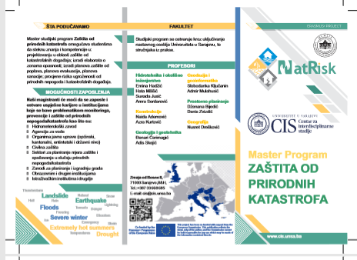

Slide 7
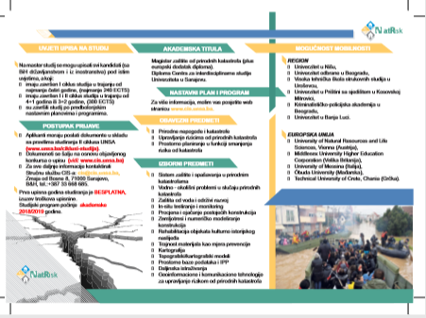

Slide 8
To do list
Development of master curricula for natural disasters risk management in Western Balkan countries
Provide link to the launched call for student enrolment All WB HEIs
Provide call for student enrolment All WB HEIs

Slide 9
Development of master curricula for natural disasters risk management in Western Balkan countries
4.2 Master curricula implemented
Description | Teaching process conducted. Selected students from each WB HEI will visit EU partner HEIs, attend lectures/exercises, compare teaching/learning methodologies in the HEI of origin and acquired knowledge with the teaching/learning methodology in EU partner HEIs and knowledge and skills of students from EU. The long-term international mobility is planned through Special Mobility Strand.
Due date | 14-10-2019

Slide 10
To do list
Development of master curricula for natural disasters risk management in Western Balkan countries
Provide two/three presentations per each subject All WB HEIs
Provide the list of enrolled students All WB HEIs
Take photos (if possible using purchased equipment) All WB HEIs
Provide decision of accreditationAll WB HEIs
Provide timetable All WB HEIs

Slide 11
Development of master curricula for natural disasters risk management in Western Balkan countries
4.3 Students’ internships
Description | The students’short-time mobility between WB HEIs is planned. The students of master studies will perform student internships in WB partner HEIs (10 UNI to UNSA, 5 KPU to UBL, 5 UNID to UNI, 5 UPKM to UNI, 2 TCASU to KPU, 5 UNSA to UNI, 5 UBL to KPA).
Due date | 14-10-2019

Slide 12
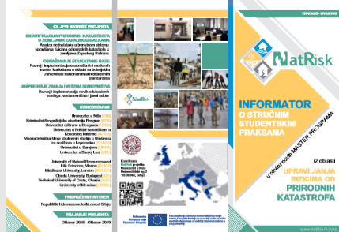

Slide 13
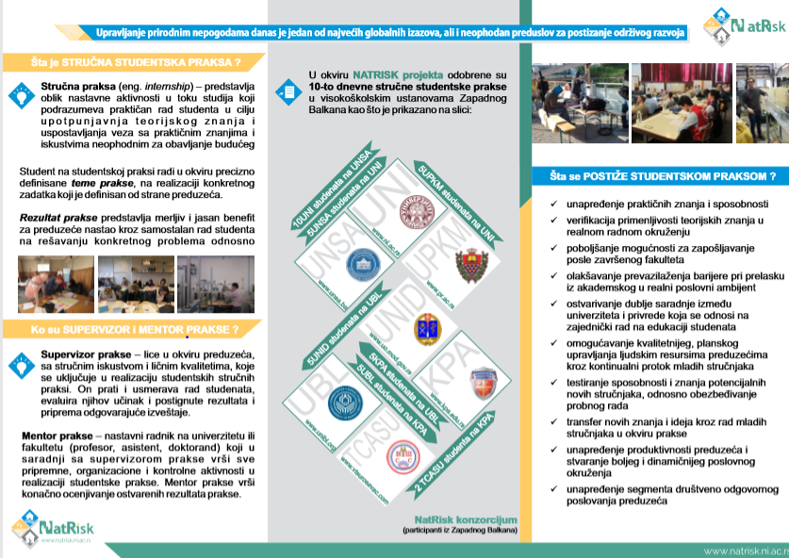

Slide 14
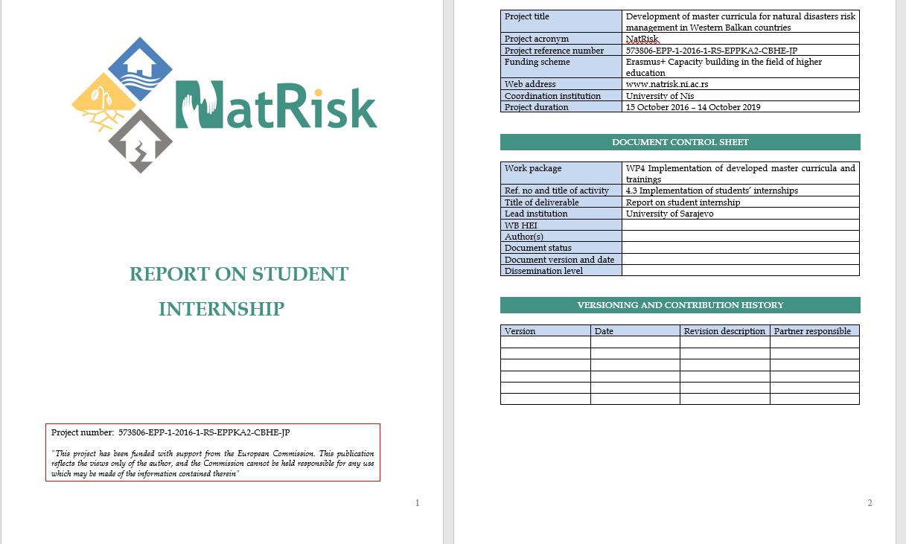
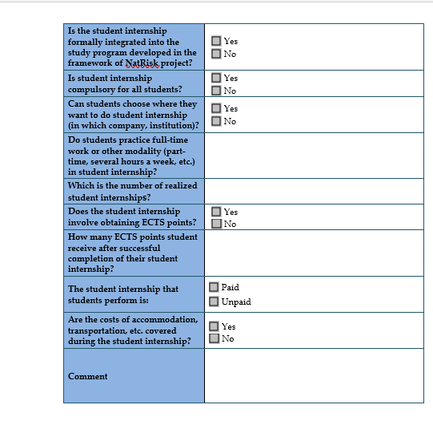
Development of master curricula for natural disasters risk management in Western Balkan countries

Slide 15
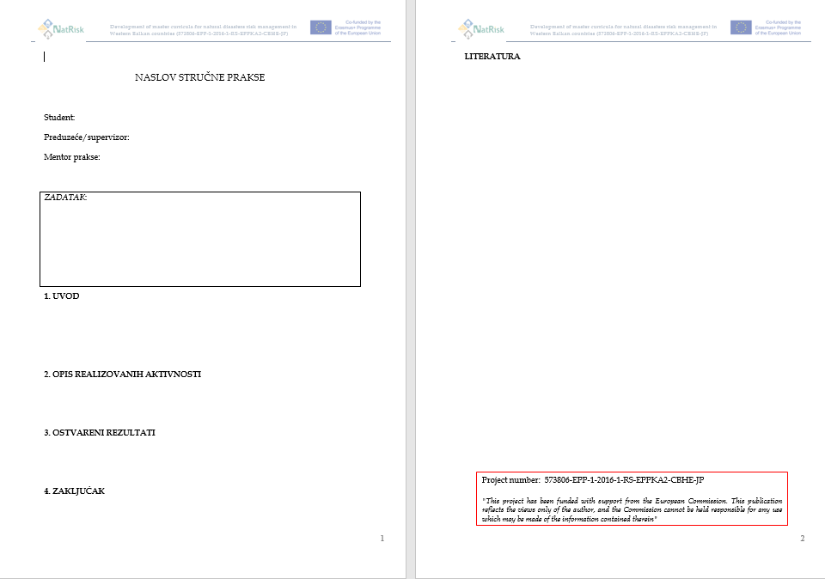
Report on professional practice

Slide 16
To do list
Development of master curricula for natural disasters risk management in Western Balkan countries
10 UNI to UNSA, 5 KPU to UBL, 5 UNID to UNI, 5 UPKM to UNI, 2 TCASU to KPU, 5 UNSA to UNI, 5 UBL to KPU = 37 x 12 days (10 + 2 for travelling) – 55 EUR per day + travelling
Deliver promotional material
Organize at the same time at the same HEI as a group work (if possible)
Take photos
Write event form and post also on HEI’s website
Report on professional practice in mother language per each student
Report on student internship KPU, UNSA, UBL, UNI

Slide 17
4.5. Quality report on master curricula
Development of master curricula for natural disasters risk management in Western Balkan countries
Description | The self-evaluation will be done twice a year (in winter and in summer semesters). The quality of teaching, including teachers’ methodological approach, availability of literature and equipment will be performed. Qualtiy reports from each WB partner HEI will be analysed and compared at SC and PMC meetings for further improvement of the newly enforced master studies.
Due date | 14-09-2019

Slide 18
To do list
Development of master curricula for natural disasters risk management in Western Balkan countries
Prepare a self-evaluation report Annex J using self-evaluation list (annex I) per each term All WB HEIs
Note: Examples can be found under WP4.5 on NatRisk platform

